Slide 1
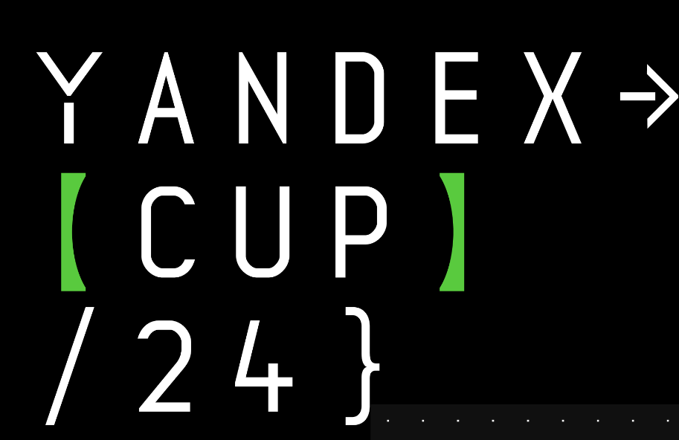
Machine Learning:
Self Driving Cars
Ионов Тимур

Slide 2

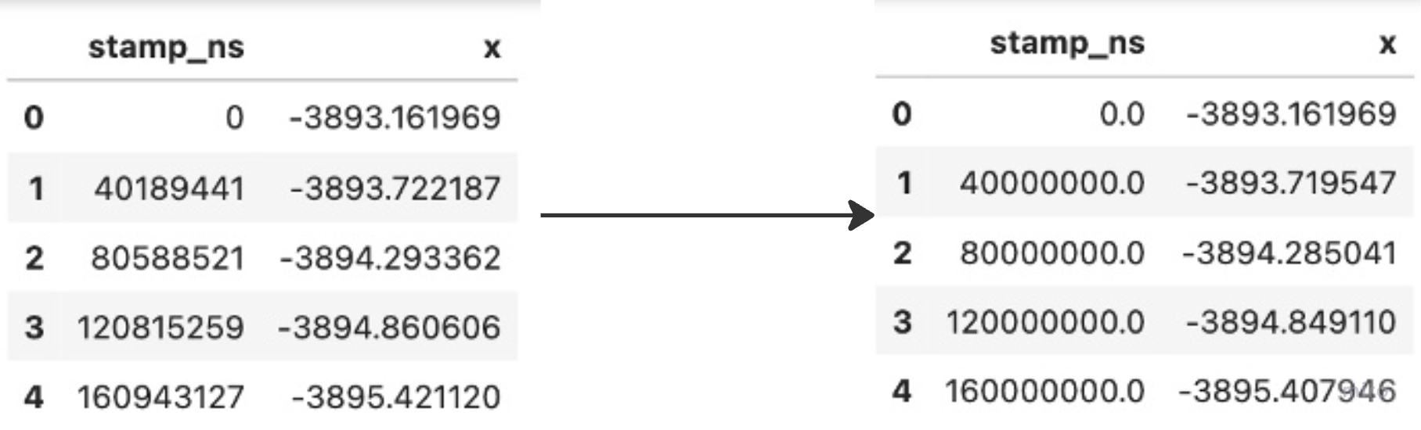
Dataset Preprocessing
Resample to unified timestamps range with 0.04 step (25 stamps per second):
training data from 0 to 60 sec
test data from 0 to 20 sec
One dimensional linear interpolation for resampling (nearest value as baseline)
Fill values outside range with nearest values
Training:
Pick random position i <= 1000
Shift x, y, z to reference point (start from 0,0,0)
[i, i+125) - input stamps (5 sec)
[i+125, i+375] – output stamps (15 sec.)
Test Inference:
Shift x, y, z to reference point
Predict
Resample back to original timestamps
Shift x, y, z back to initial

Slide 3
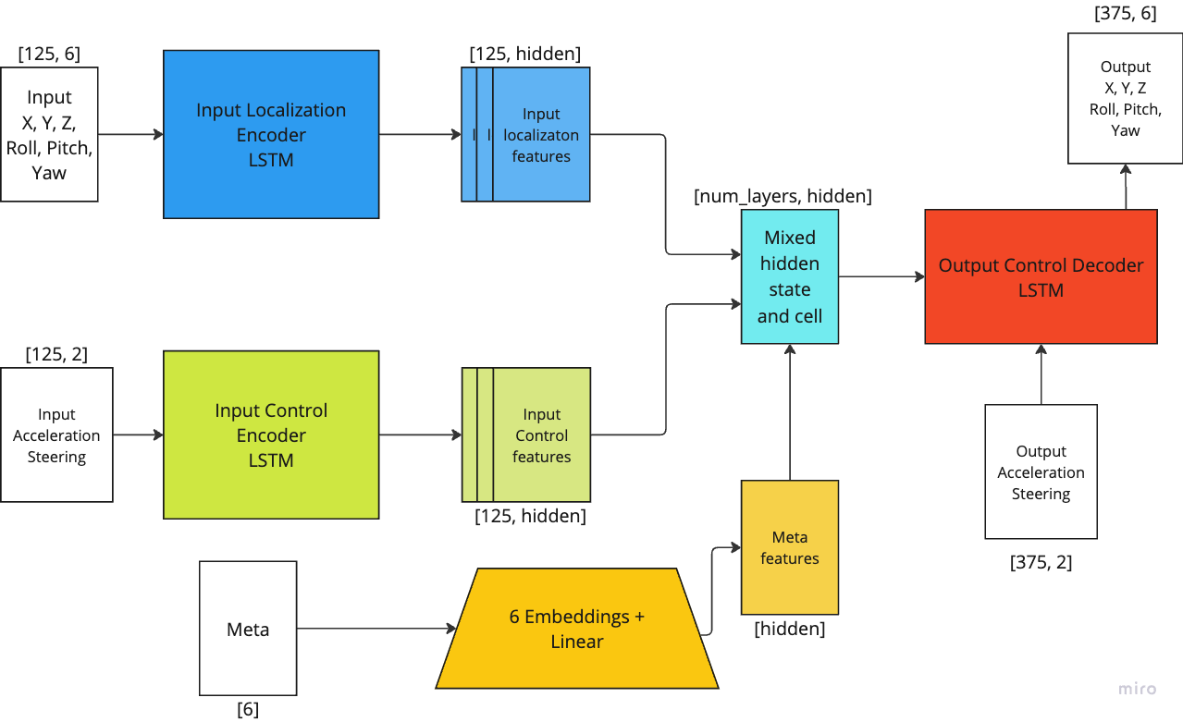
Model. Vanilla baseline
Lstm N layers | 3
hidden | 256
Params | 4M
Epoch time | 50 sec
Score | 1.21
Notes:
+ score

Slide 4
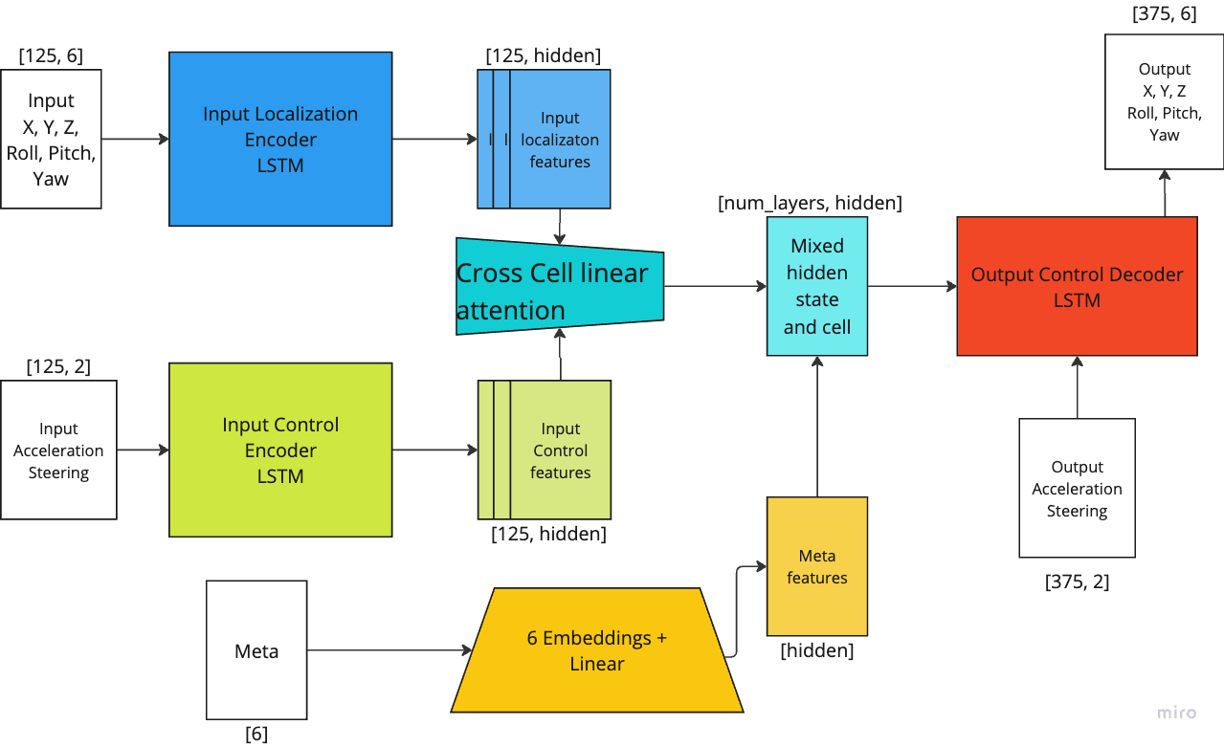
Model. Hidden state attention.
Lstm N layers | 3
hidden | 256
Params | 4.3M
Epoch time | 52 sec
Score | 1.9

Slide 5
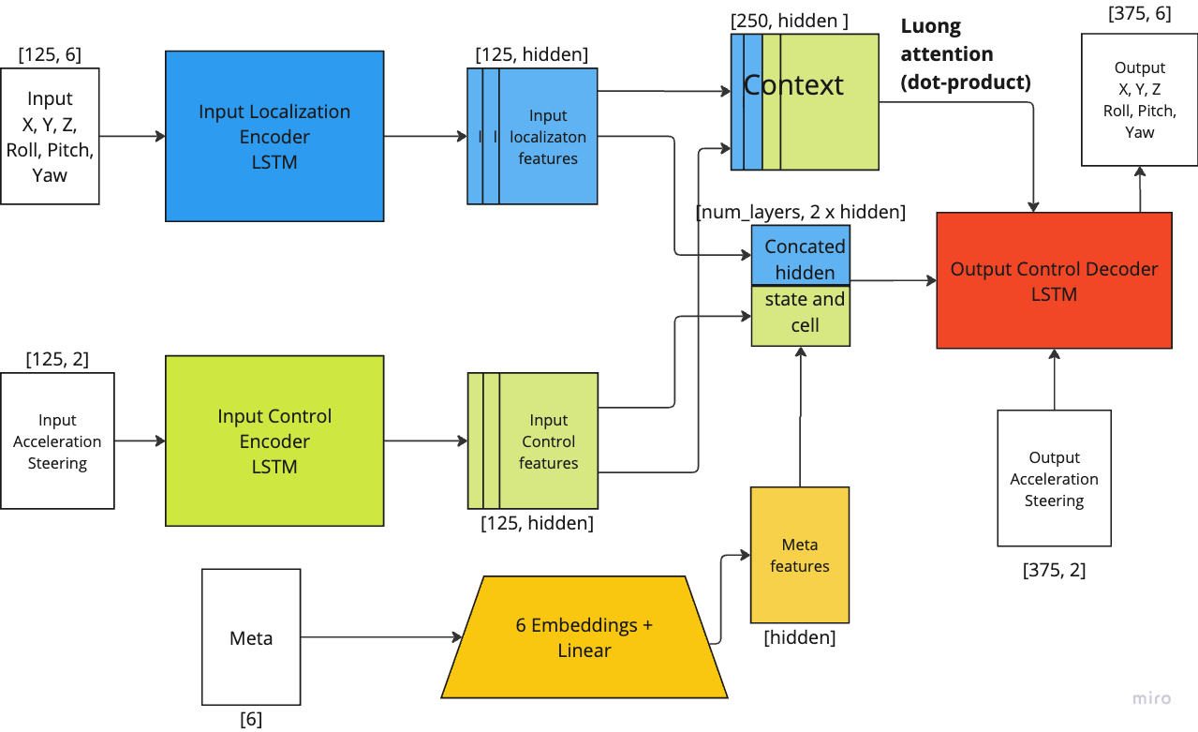
Model. Luong attention.
Lstm N layers | 3
hidden | 256
Params | 8M
Epoch time | 67 sec
Score | 0.98

Slide 6
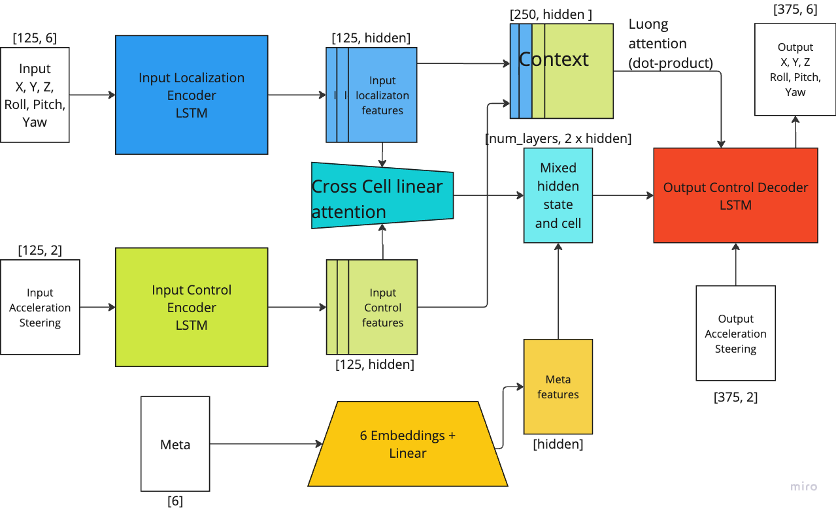
Model. Dual attention
Lstm N layers | 3
hidden | 256
Params | 8.5M
Epoch time | 69 sec
Score | 1.02

Slide 7
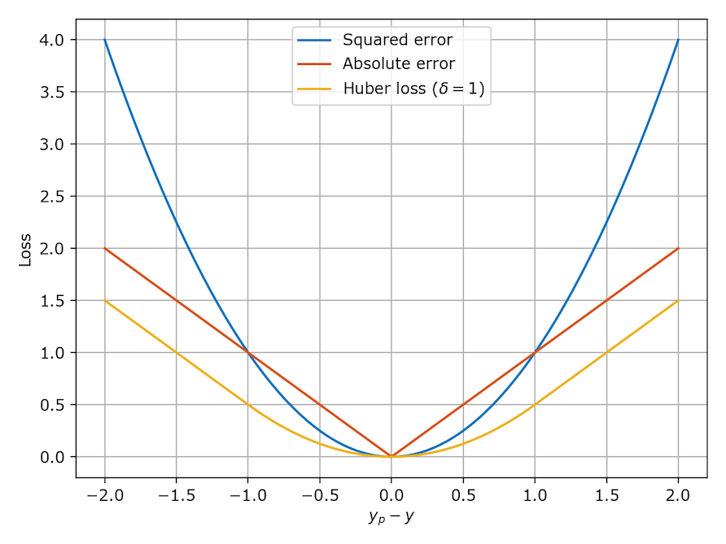
Scheduler & Loss
Loss:
Huber loss
Loss weights (normalized) for x, y, z, roll, pitch, yaw: 3, 3, 1, 1, 1, 3
(MSE is also ok)
Scheduler:
Reduce on plateau:
factor 0.9
patience 50
Cosine warm-up with restarts:
T_max 100 or 200
T_mult 1

Slide 8
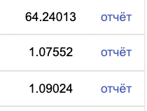
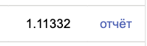
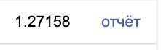
Lightning trick
4.5 days till the end
4 folds in training
30 hours of training, validation loss decreasing
Check ”best-model” on Public:

Slide 9

Lightning trick
Overfit?
Validation leakage?
Weights explosion?
Inference bug?
Shake-up?
4.5 days till the end
4 folds in training
30 hours of training, validation loss decreasing
Check ”best-model” on Public:
Notes:
+ meme

Slide 10
Lightning trick
Stopped all trainings
Rechecked all sources
Changed scheduler to Cosine Cycle with Warm-up and restarts for some folds
Added 0.2 dropout for every linear and embedding layer
Change inference resampling from np.searchsorted to linear interp1d (+2-3% metric boost for every model)

Slide 11
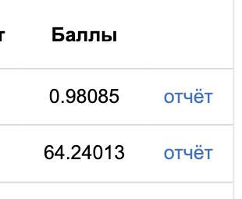
Lightning trick
There were two best checkpoints in folder:
best-model.ckpt – from dummy, early stopped run
best-model-v1.ckpt – from actual run
I lost:
4-5 hours of dev
48 hours of compute
good models, fine pipeline
I earned:
Priceless life lesson
High risk – high value opportunity with training updates

Slide 12
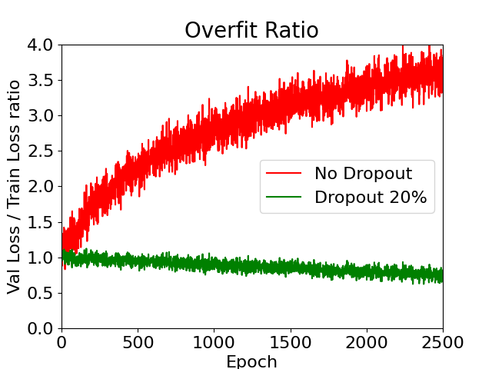
Overfit ratio
Overfit ratio (Val loss / Train loss):
No dropout – 3.5 +- 1
Dropout – 0.9 +- 0.1
Metircs:
No dropout – 0.99+-0.03
Dropout – 1.02+-0.03

Slide 13
Things that didn't work
Data:
Data normalization (any)
Additional features: dx, dy, ddx, ….
Sequence length augmentation (+- 3 timestamps)
Timestamp lag for control sequence
Models:
Transformer – 25 train/val metric, early plateau
Conformer – 6 train, 12 val, 16 public metric, early overfit, plateau
Bahdanau attention – too slow, nan loss after few epochs
Actually, didn't have time or patience for a detailed review.

Slide 14
Result ensemble
N folds | layers | hidden | scheduler | attn | dropout | epochs | Val score | Cum Sum public
2 | 3 | 196 | reduce | luong | 0 | 1900±50 | 0.99±0.01 | 0.92
4 | 2 | 256 | coswr | dual | 0.2 | 2500 | 1.02±0.02 | 0.87
1 | 2 | 512 | coswr | dual | 0.2 | 2500 | 1.1 | 0.86
2 | 4 | 256 | coswr | dual | 0.2 | 1400 | 1.05±002 | 0.85

Slide 15
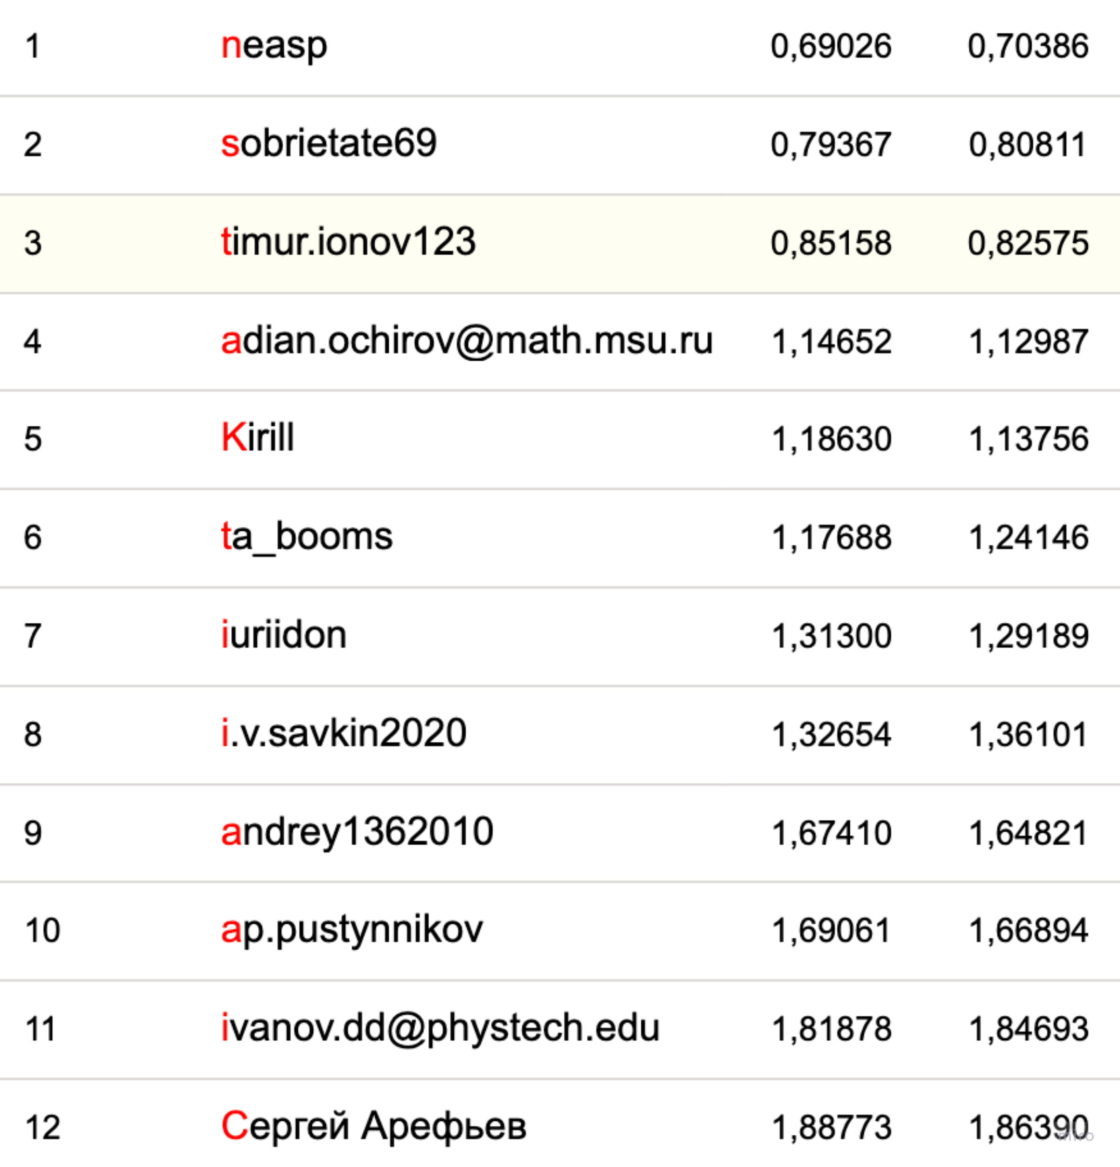
Results
Simple things first
One change a time (if possible)
Make your code clean as soon as possible
Commit everything
Be “calm”
Calculate time for blending

Slide 16




Links. let’s network
Master @ ITMO
LLM Researcher @
Hacks hater, leaderbord enjoyer
TG: @sir_timio
TG Channel: @ai_minds
solution

